Slide 1
Chapter 16 Chemistry of Benzene: Electrophilic Aromatic Substitution

Slide 2
Learning Objectives
(16.1)
Electrophilic aromatic substitution reactions: Bromination
(16.2)
Other aromatic substitutions
(16.3)
Alkylation and acylation of aromatic rings: The Friedel-Crafts reaction
(16.4)
Substituent effects in electrophilic substitutions

Slide 3
(16.5)
Trisubstituted benzenes: Additivity of effects
(16.6)
Nucleophilic aromatic substitution
(16.7)
Benzyne
(16.8)
Oxidation of aromatic compounds

Slide 4
(16.9)
Reduction of aromatic compounds
(16.10)
Synthesis of polysubstituted benzenes

Slide 5
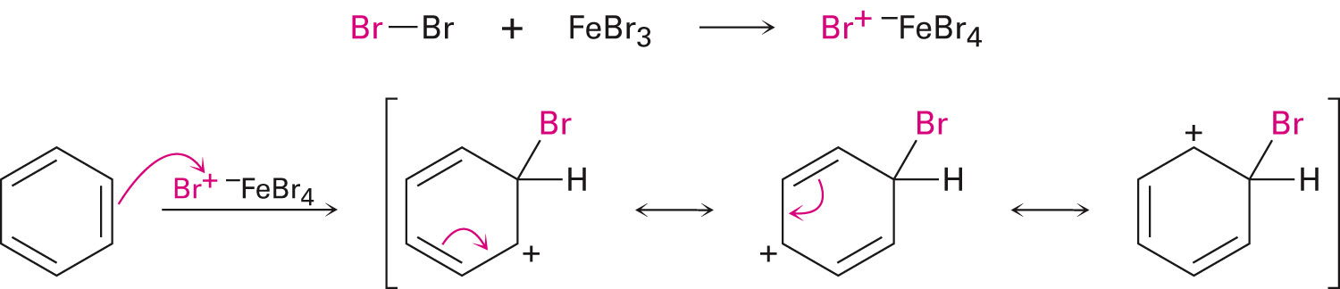
Electrophilic Aromatic Substitution Reactions: Bromination
An electrophile reacts with an aromatic ring to substitute a hydrogen on the ring
The beginning of the reaction is similar to that of electrophilic alkene reactions
The difference is that alkenes react more readily with electrophiles than aromatic rings
In the bromination of benzene, a catalyst such as FeBr₃ is used
Notes:
Electrophilic aromatic substitution reactions: Bromination

Slide 6
Electrophilic Aromatic Substitution Reactions: Bromination
Stability of the intermediate in electrophilic aromatic substitution is lesser than that of the starting benzene ring
Reaction of an electrophile is endergonic, possesses substantial activation energy, and comparatively slow
Notes:
Electrophilic aromatic substitution reactions: Bromination

Slide 7
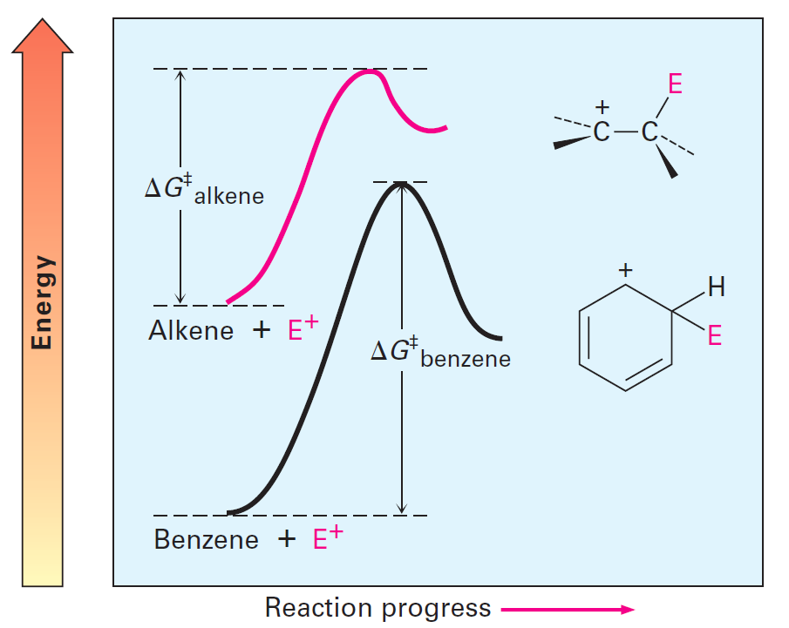
Figure 16.1 - Electrophile Reactions With an Alkene and With Benzene
Notes:
Electrophilic aromatic substitution reactions: Bromination

Slide 8
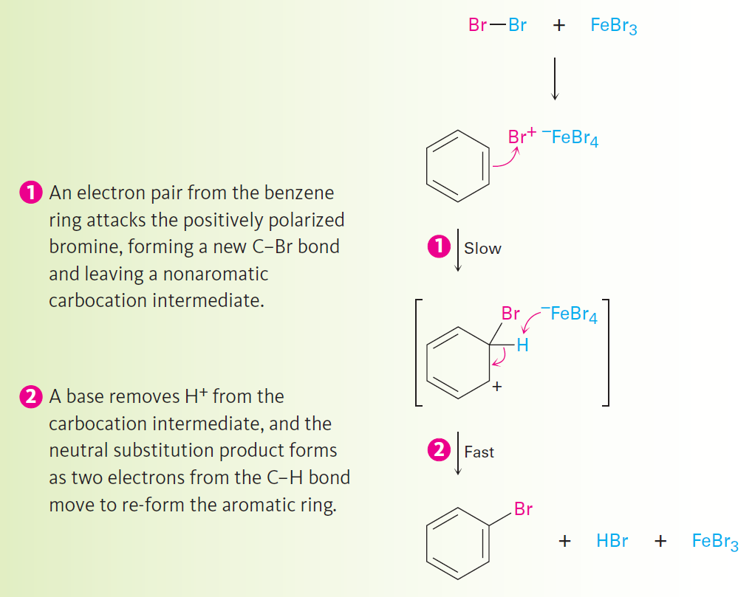
Figure 16.2 - Electrophilic Bromination of Benzene
Notes:
Electrophilic aromatic substitution reactions: Bromination

Slide 9
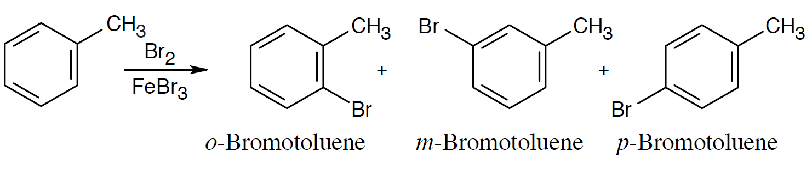
Worked Example
Monobromination of toluene gives a mixture of three bromotoluene products
Draw and name them
Solution:
Notes:
Electrophilic aromatic substitution reactions: Bromination

Slide 10
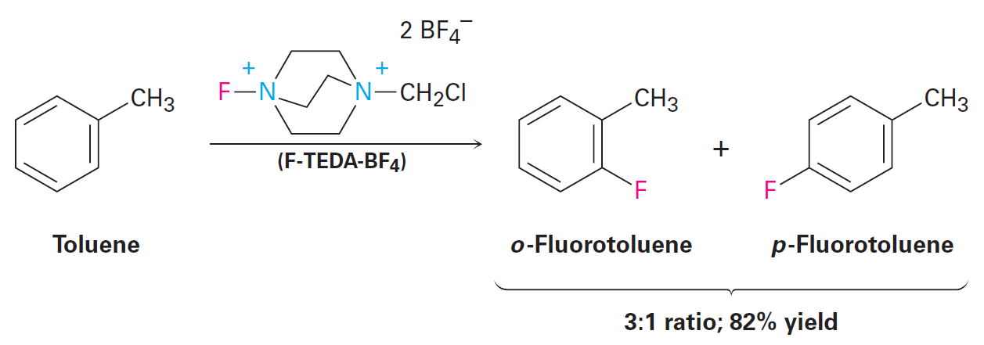
Other Aromatic Substitutions
Chlorine and iodine (but not fluorine, which is too reactive) can produce aromatic substitution with the addition of other reagents to promote the reaction
Notes:
Other aromatic substitutions

Slide 11
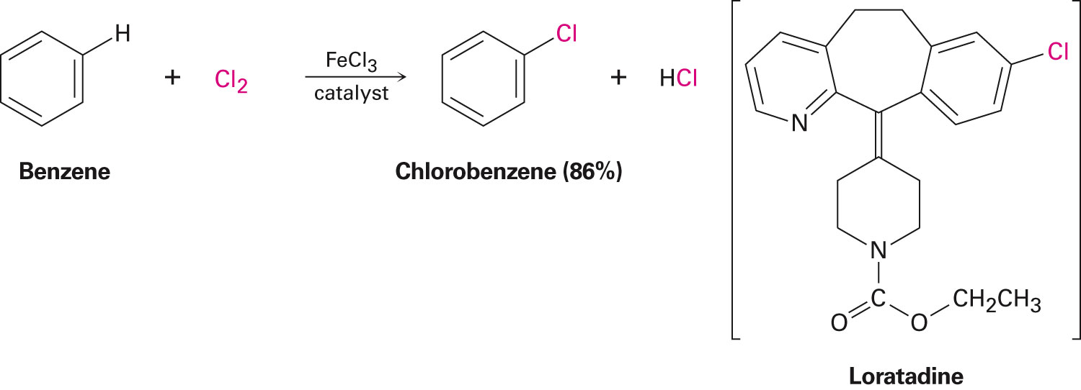
Other Aromatic Substitutions
Aromatic rings produce chlorobenzenes when they react with Cl₂ with FeCl₃ as a catalyst
Pharmaceutical agents such as Claritin are manufactured by a similar reaction
Notes:
Other aromatic substitutions

Slide 12
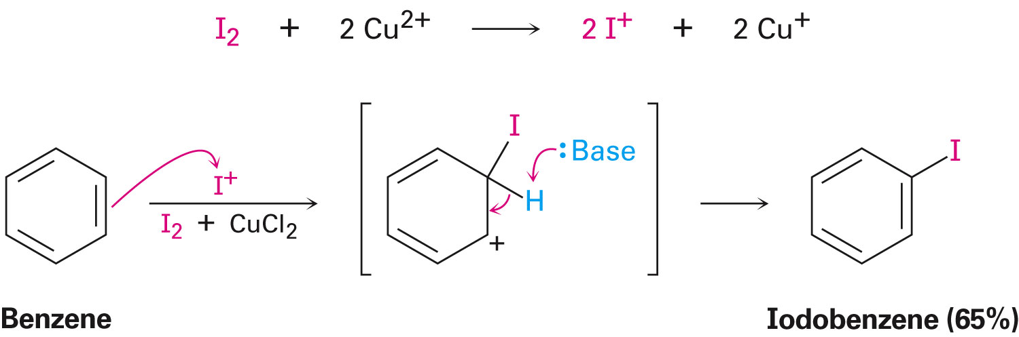
Other Aromatic Substitutions
Since iodine is unreactive toward aromatic rings, oxidizing agents such as CuCl₂ are used as a catalyst
CuCl₂ oxidizes I₂ resulting in the production of a substitute
Notes:
Other aromatic substitutions

Slide 13
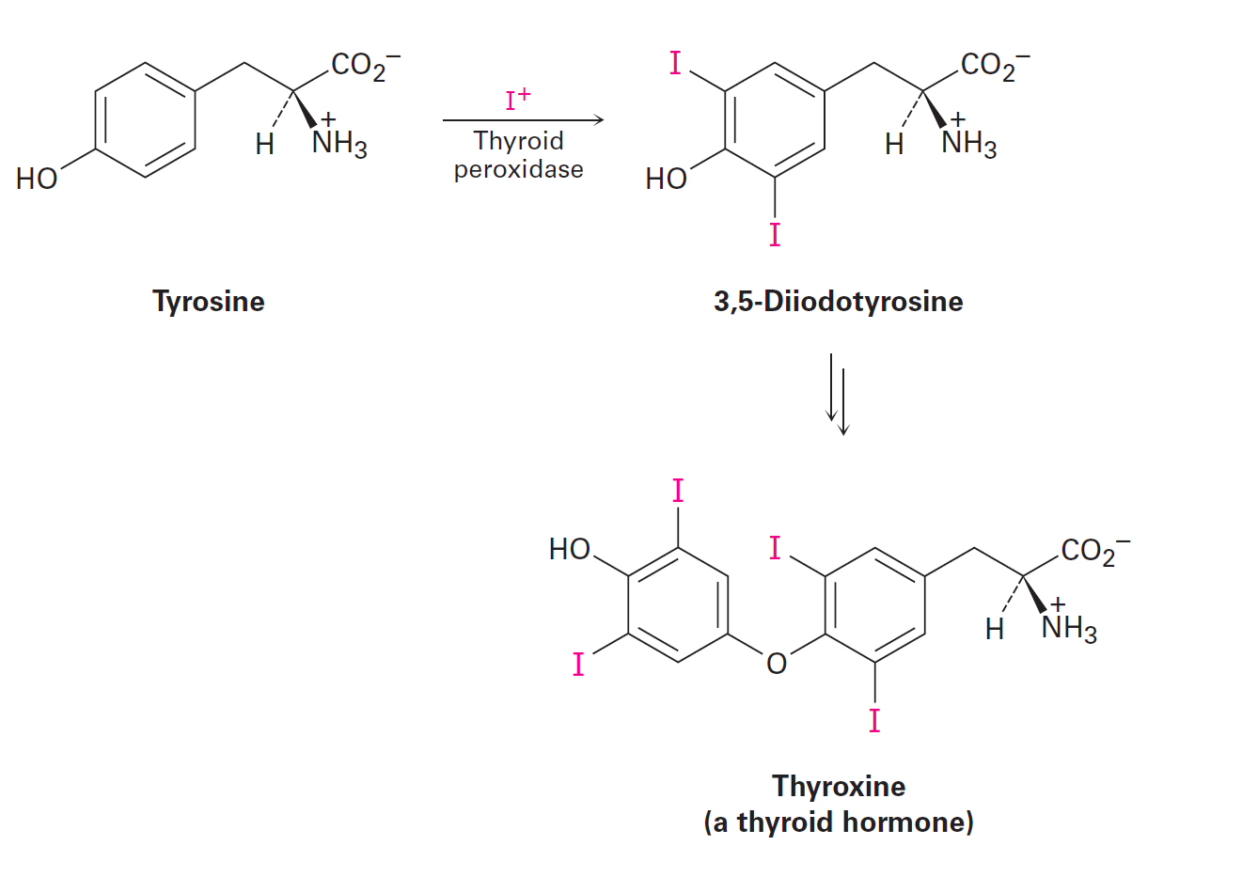
Natural Electrophilic Aromatic Halogenations
Widely found in marine organisms
Occurs in the biosynthesis of thyroxine in humans
Notes:
Other aromatic substitutions

Slide 14
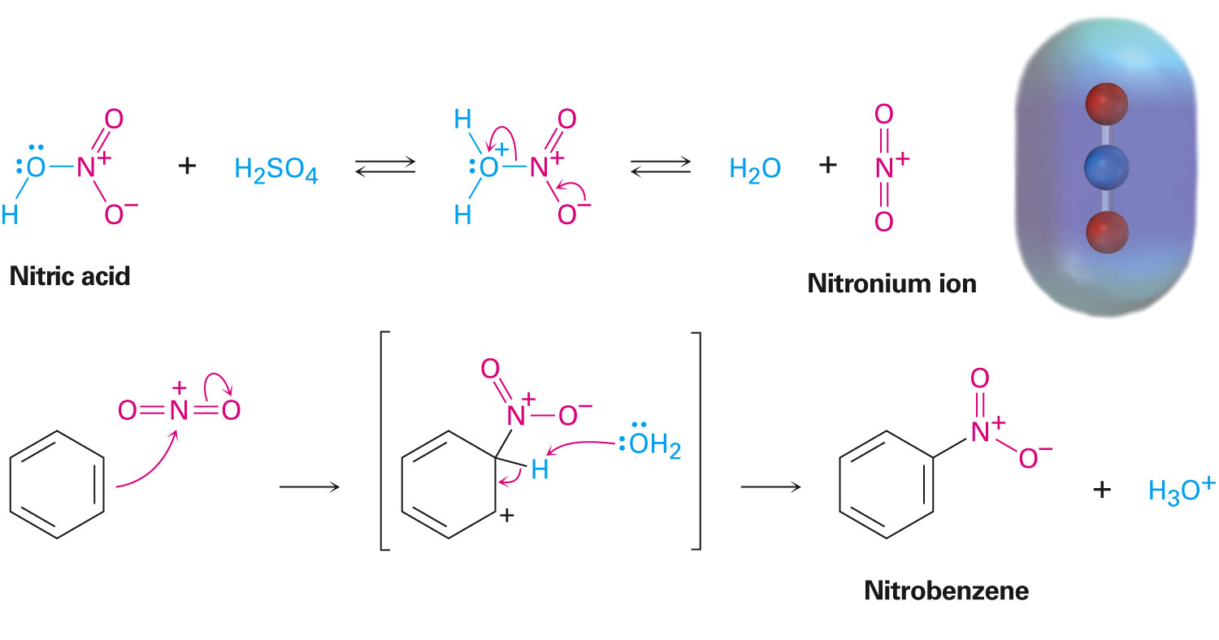
Aromatic Nitration
Combination of concentrated nitric acid and sulfuric acid results in NO₂⁺ (nitronium ion)
Reaction with benzene produces nitrobenzene
Notes:
Other aromatic substitutions

Slide 15
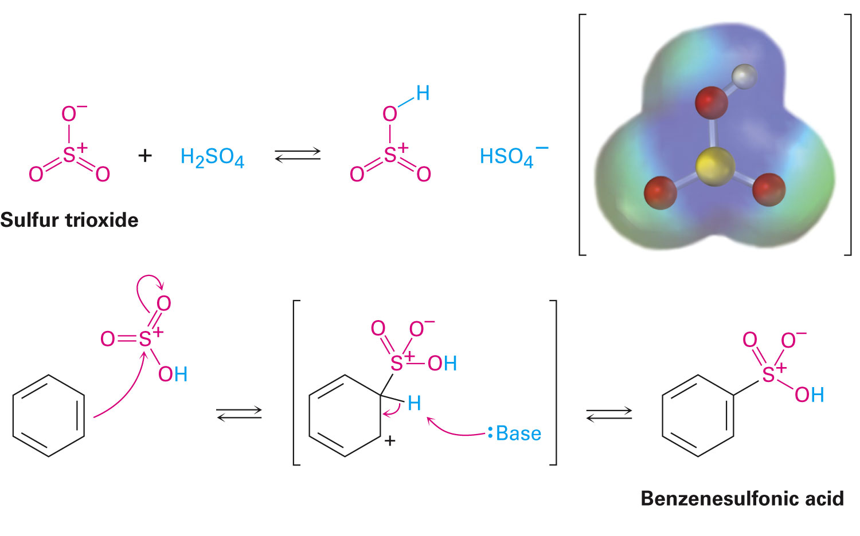
Aromatic Sulfonation
Occurs by a reaction with fuming sulphuric acid, a mixture of H₂SO₄, and SO₃
The reactive electrophile is either HSO₃⁺ or neutral SO₃
Notes:
Other aromatic substitutions

Slide 16
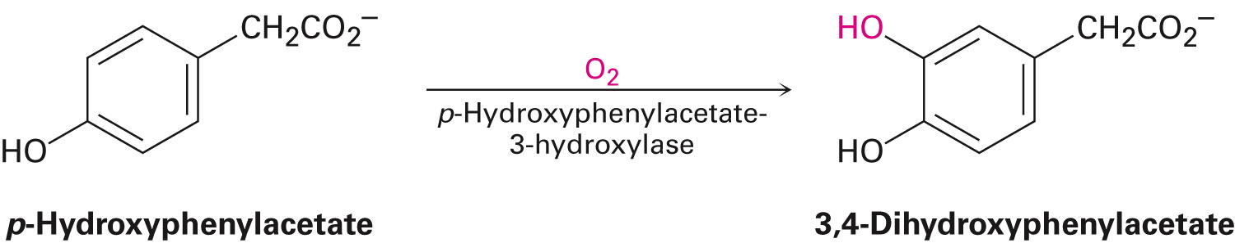
Aromatic Hydroxylation
Direct hydroxylation of an aromatic ring is difficult in the laboratory
Usually occurs in biological pathways
Notes:
Other aromatic substitutions

Slide 17
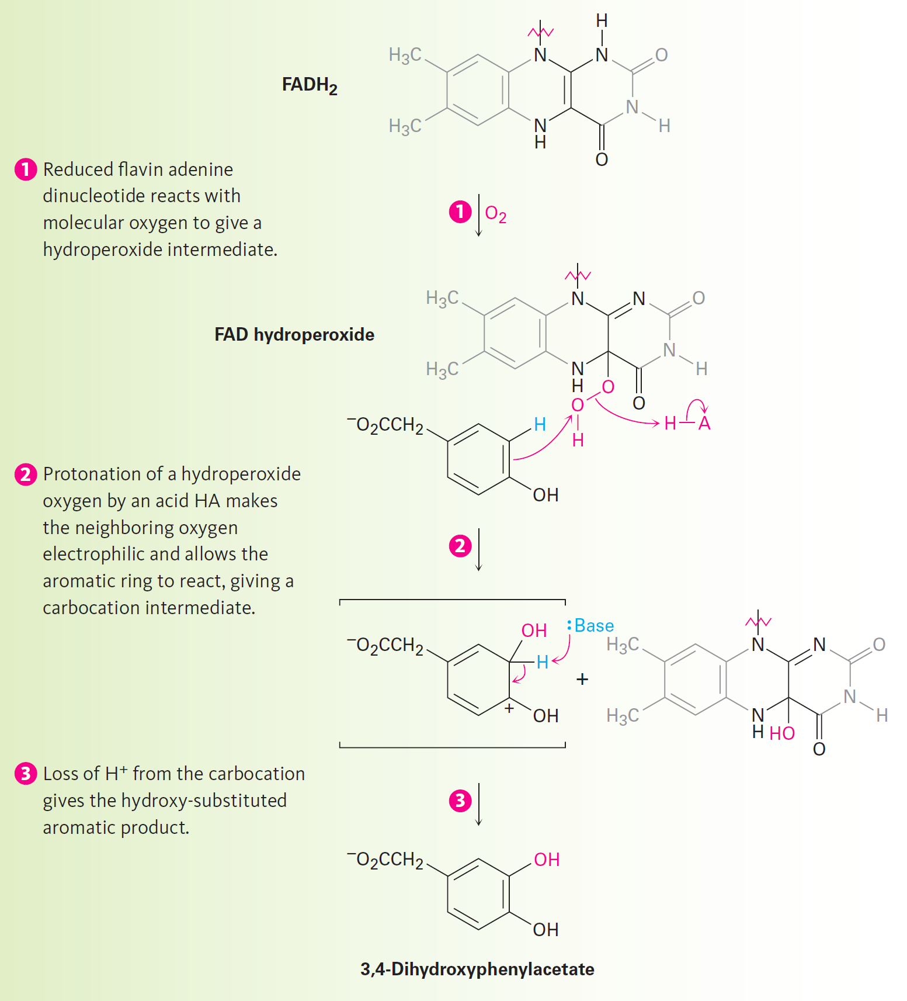
Figure 16.6 - Mechanism for the Electrophilic Hydroxylation of p-hydroxyphenylacetate
Notes:
Other aromatic substitutions

Slide 18
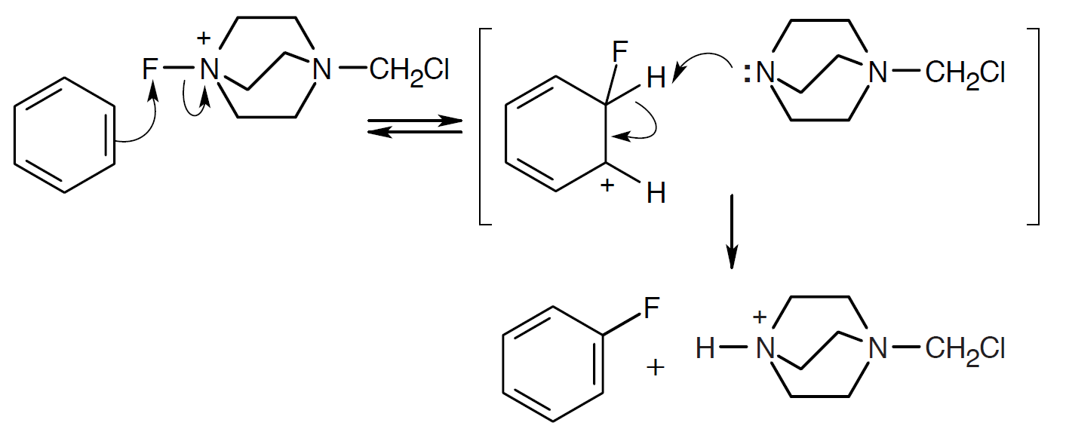
Worked Example
Propose a mechanism for the electrophilic fluorination of benzene with F-TEDA-BF₄
Solution:
Notes:
Other aromatic substitutions

Slide 19
Worked Example
The pi electrons of benzene attack the fluorine of F-TEDA-BF₄
The nonaromatic intermediate loses –H to give the fluorinated product
Notes:
Other aromatic substitutions

Slide 20
Alkylation of Aromatic Rings: The Friedel-Crafts Reaction
Alkylation: Introducing an alkyl group onto the benzene ring
Also called the Friedel-Crafts reaction
Involves treatment of an aromatic compound with an alkyl chloride to yield a carbocation electrophile
Aluminium chloride used as a catalyst which causes dissociation of the alkyl halide
Notes:
Alkylation and acylation of aromatic rings: The Friedel-Crafts reaction

Slide 21
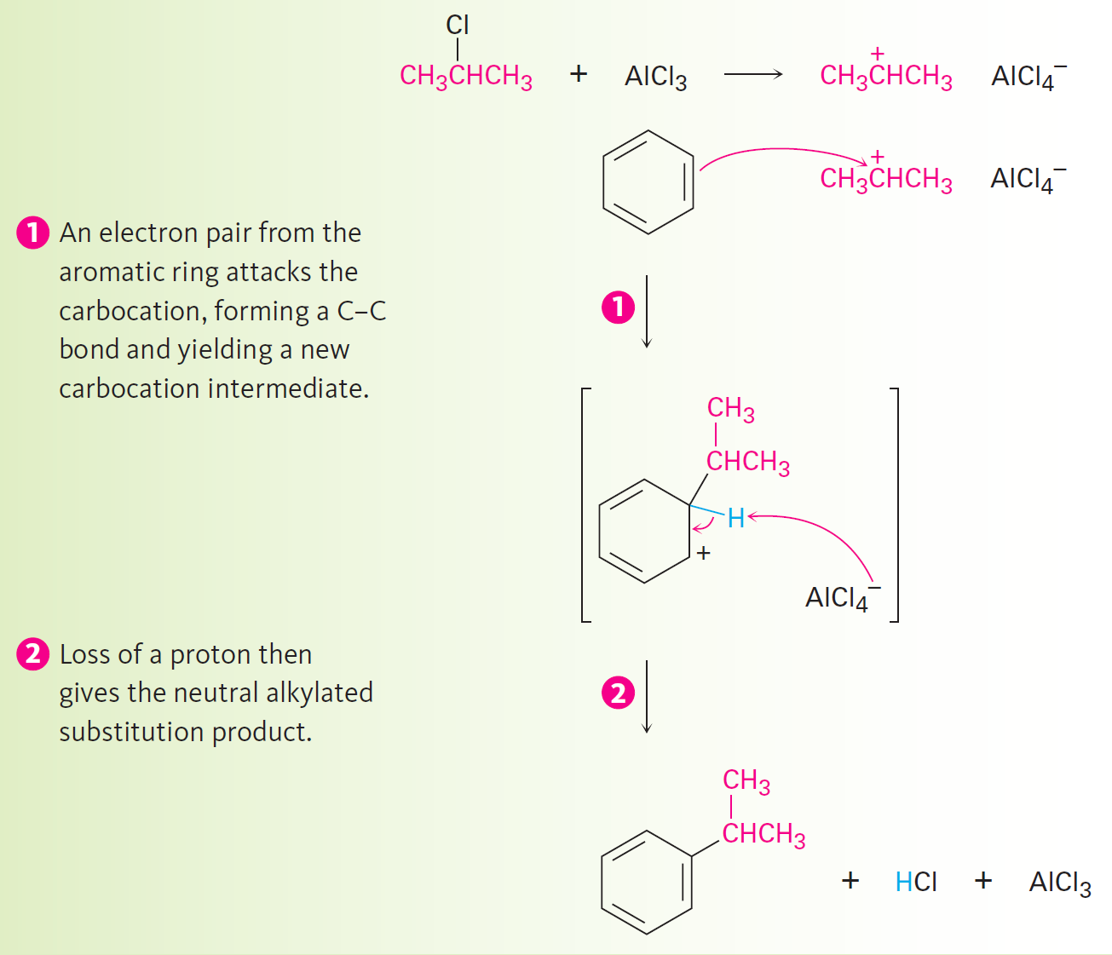
Figure 16.7 - Mechanism of the Friedel-Crafts Reaction
Notes:
Alkylation and acylation of aromatic rings: The Friedel-Crafts reaction

Slide 22
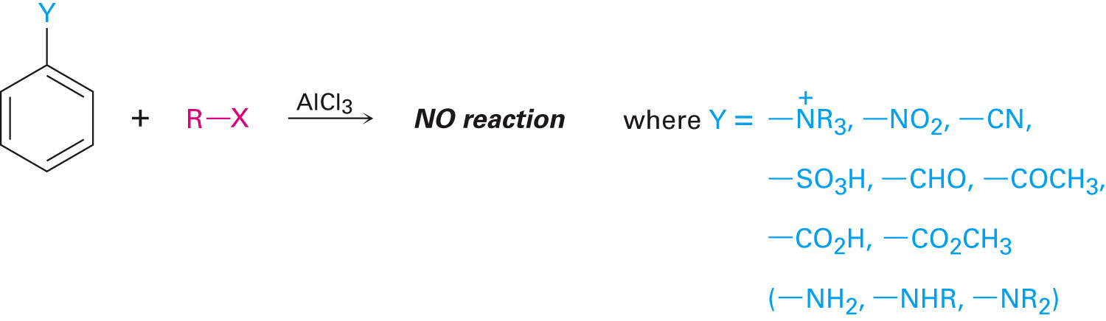
Limitations of the Friedel-Crafts Reaction
Only alkyl halides can be used (F, Cl, I, Br)
High energy levels of aromatic and vinylic halides are not suitable to Friedel-Crafts requirements
Not feasible on rings containing an amino group substituent or a strong electron-withdrawing group
Notes:
Alkylation and acylation of aromatic rings: The Friedel-Crafts reaction

Slide 23
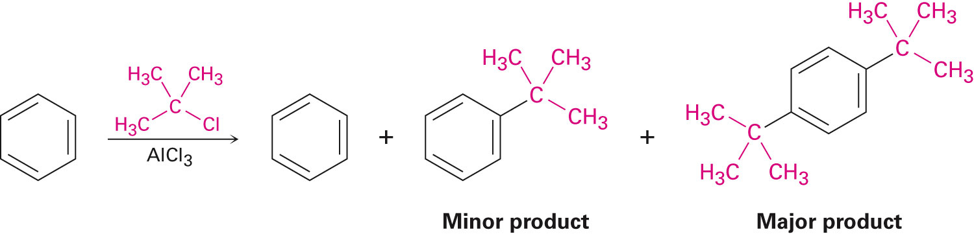
Limitations of the Friedel-Crafts Reaction
Termination of the reaction allowing a single substitution is difficult
Polyalkylation occurs
Notes:
Alkylation and acylation of aromatic rings: The Friedel–Crafts reaction

Slide 24
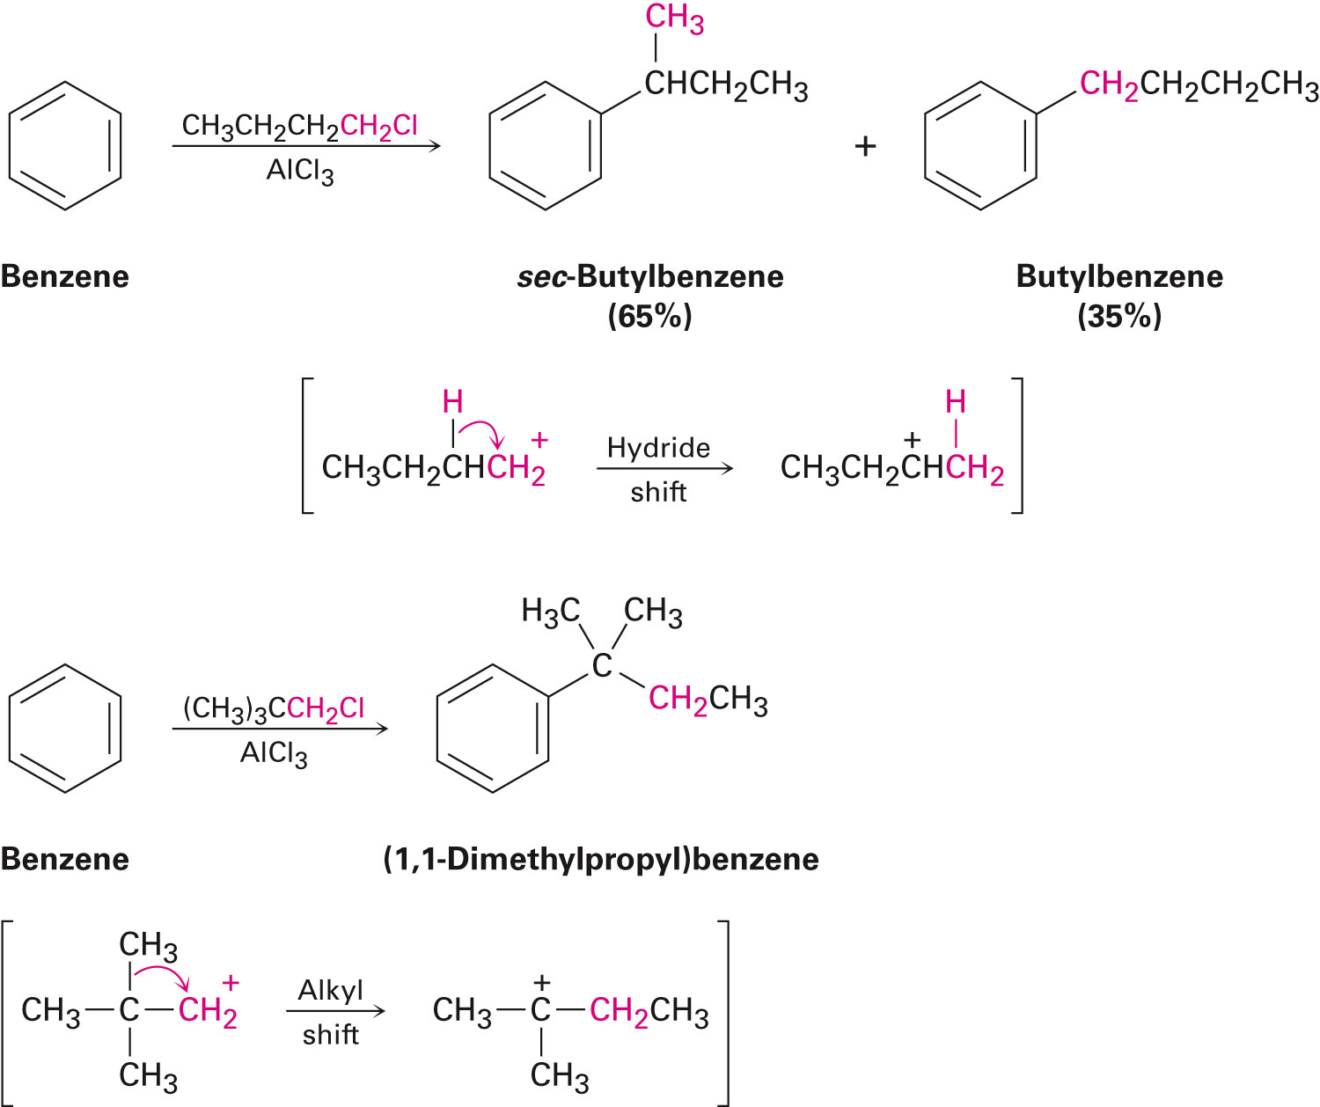
Limitations of the Friedel-Crafts Reaction
Occasional skeletal rearrangement of the alkyl carbocation electrophile
Occurs more often with the use of a primary alkyl halide
Notes:
Alkylation and acylation of aromatic rings: The Friedel–Crafts reaction

Slide 25
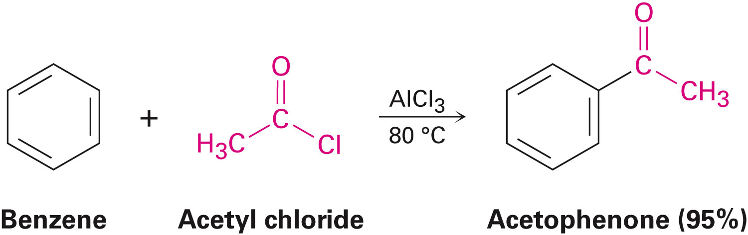
Acylation of Aromatic Rings
Acylation: Reaction of an aromatic ring with a carboxylic acid chloride in the presence of AlCl₃ resulting in an acyl group substitution
Notes:
Alkylation and acylation of aromatic rings: The Friedel–Crafts reaction

Slide 26
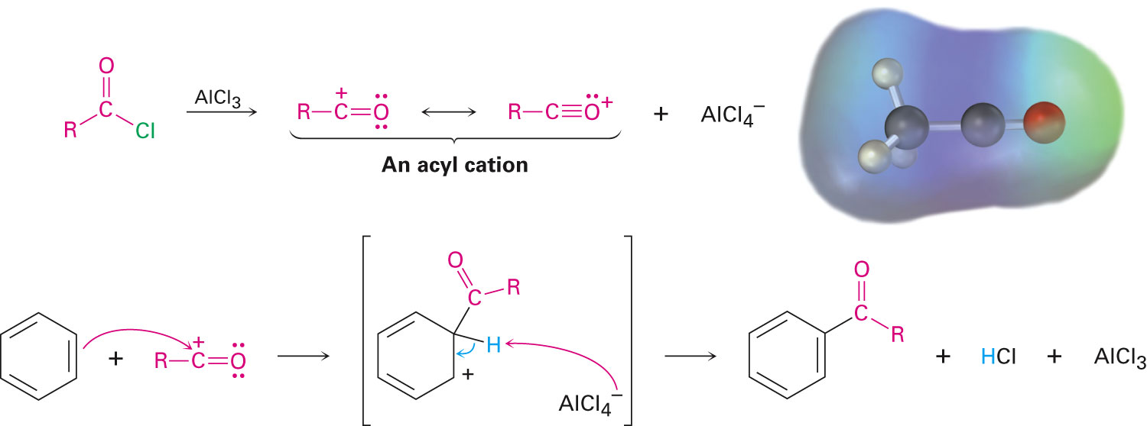
Mechanism of Friedel-Crafts Acylation
Similar to Freidel-Crafts alkylation and also possesses the same limitations on the aromatic substrate
Notes:
Alkylation and acylation of aromatic rings: The Friedel–Crafts reaction

Slide 27
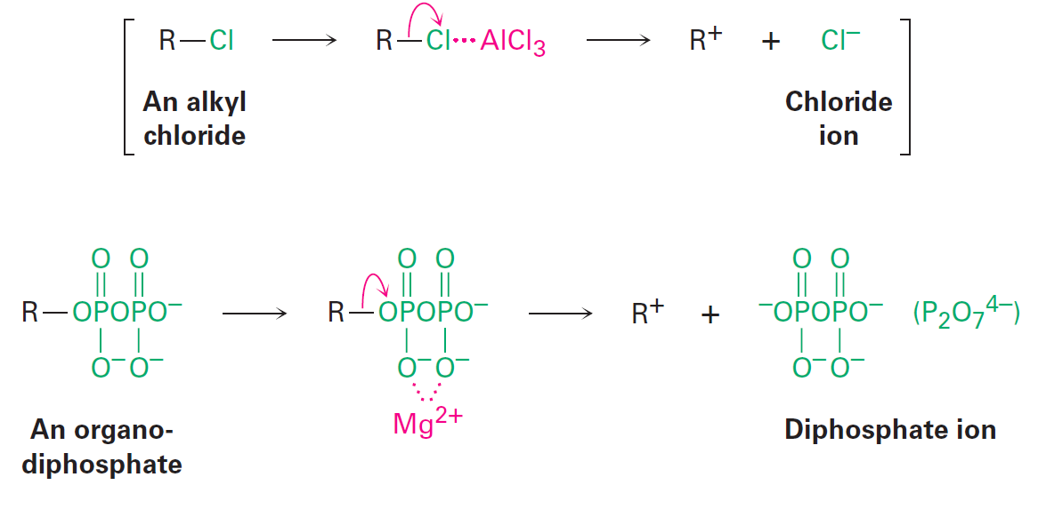
Alkylation of Aromatic Rings: The Friedel-Crafts Reaction
Natural aromatic alkylations are a part of many biological pathways
Catalyzing effect of AlCl₃ is replaced by organidiphosphate dissociation
Notes:
Alkylation and acylation of aromatic rings: The Friedel–Crafts reaction

Slide 28
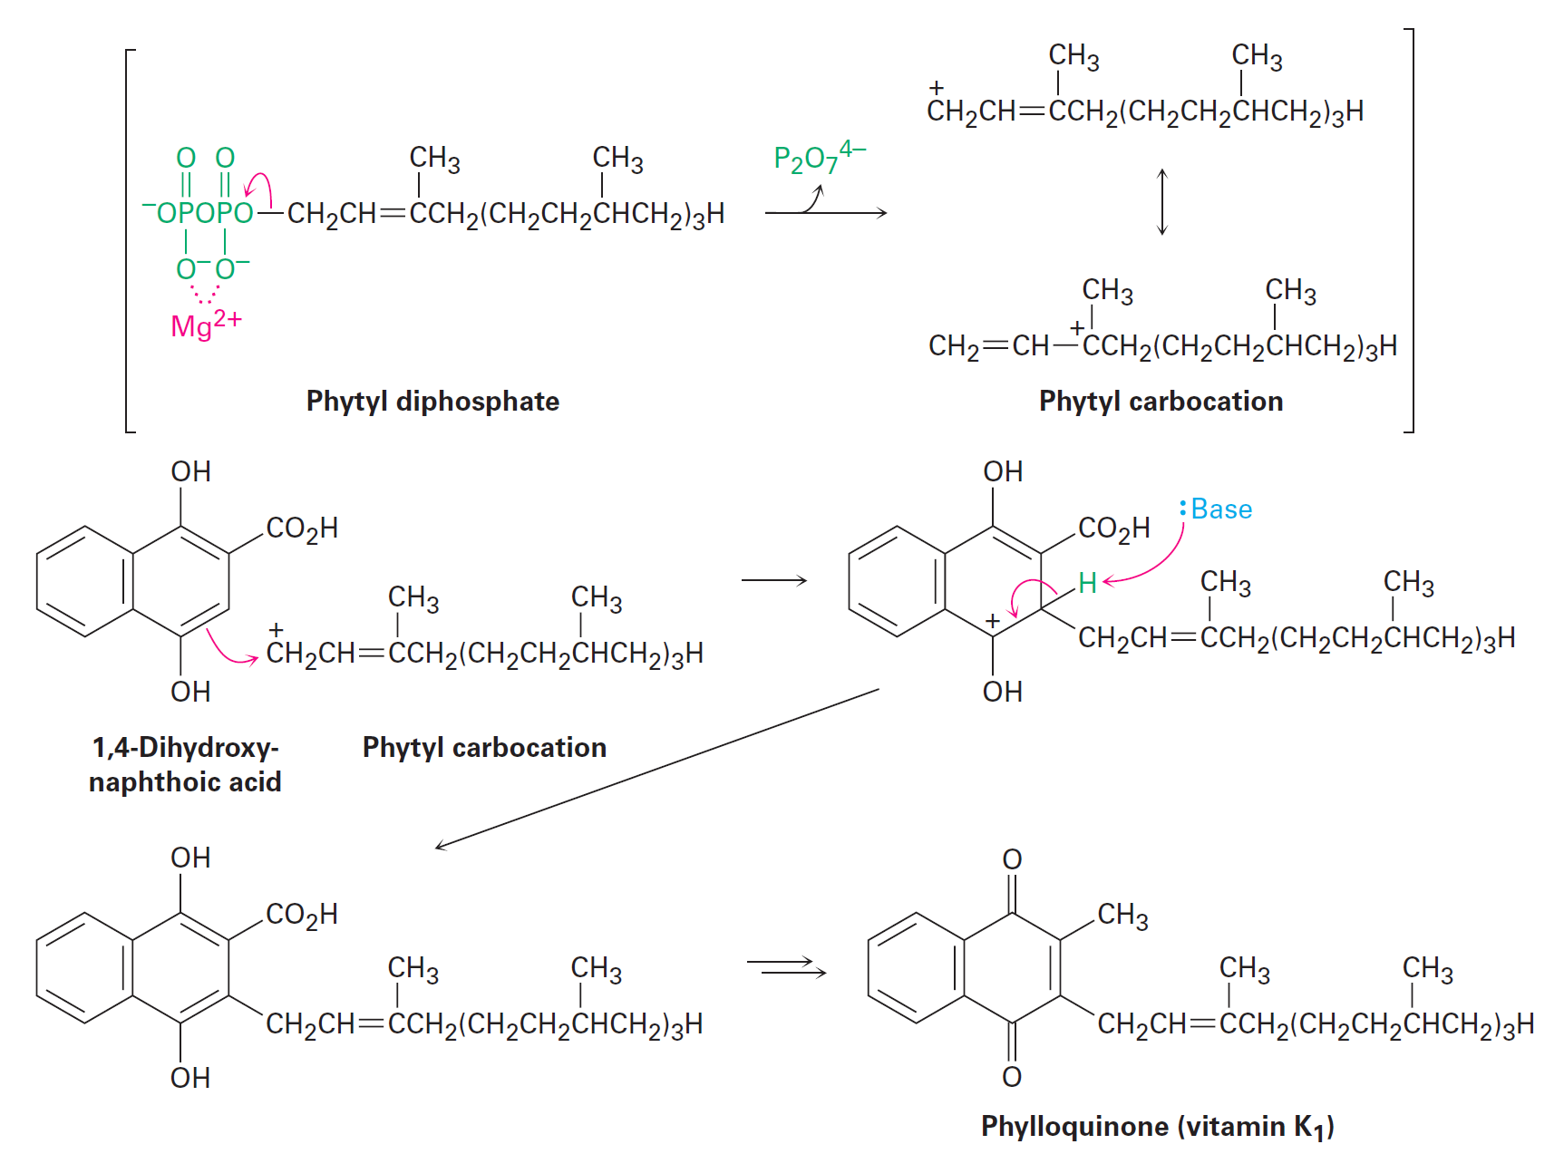
Figure 16.10 - Biosynthesis of Phylloquinone from 1,4- dihydroxynaphthoic Acid
Notes:
Alkylation and acylation of aromatic rings: The Friedel–Crafts reaction

Slide 29
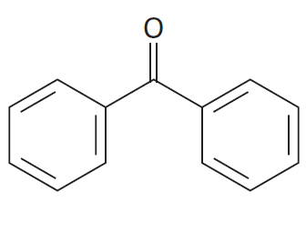
Worked Example
Identify the carboxylic acid that might be used in a Friedel-Crafts acylation to prepare the following acylbenzene
Notes:
Alkylation and acylation of aromatic rings: The Friedel–Crafts reaction

Slide 30
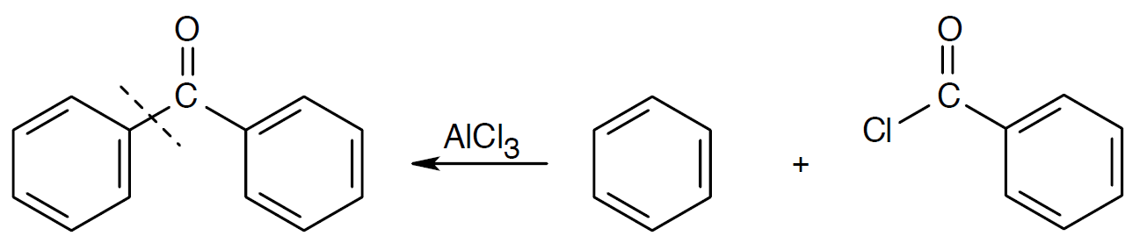
Worked Example
Solution:
Identification of the carboxylic acid chloride used in the Friedel-Crafts acylation of benzene involves:
Breaking the bond between benzene and the ketone carbon
Using a –Cl replacement
Notes:
Alkylation and acylation of aromatic rings: The Friedel–Crafts reaction

Slide 31
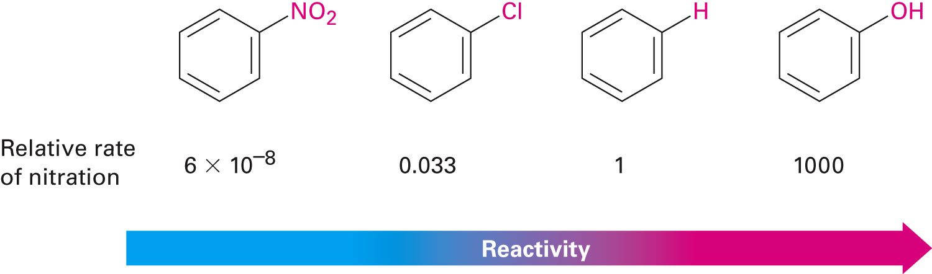
Substituent Effects in Substituted Aromatic Rings
Reactivity of the aromatic ring is affected
Substitution can result in an aromatic ring with a higher or a lower reactivity than benzene
Notes:
Substituent effects in electrophilic substitutions

Slide 32
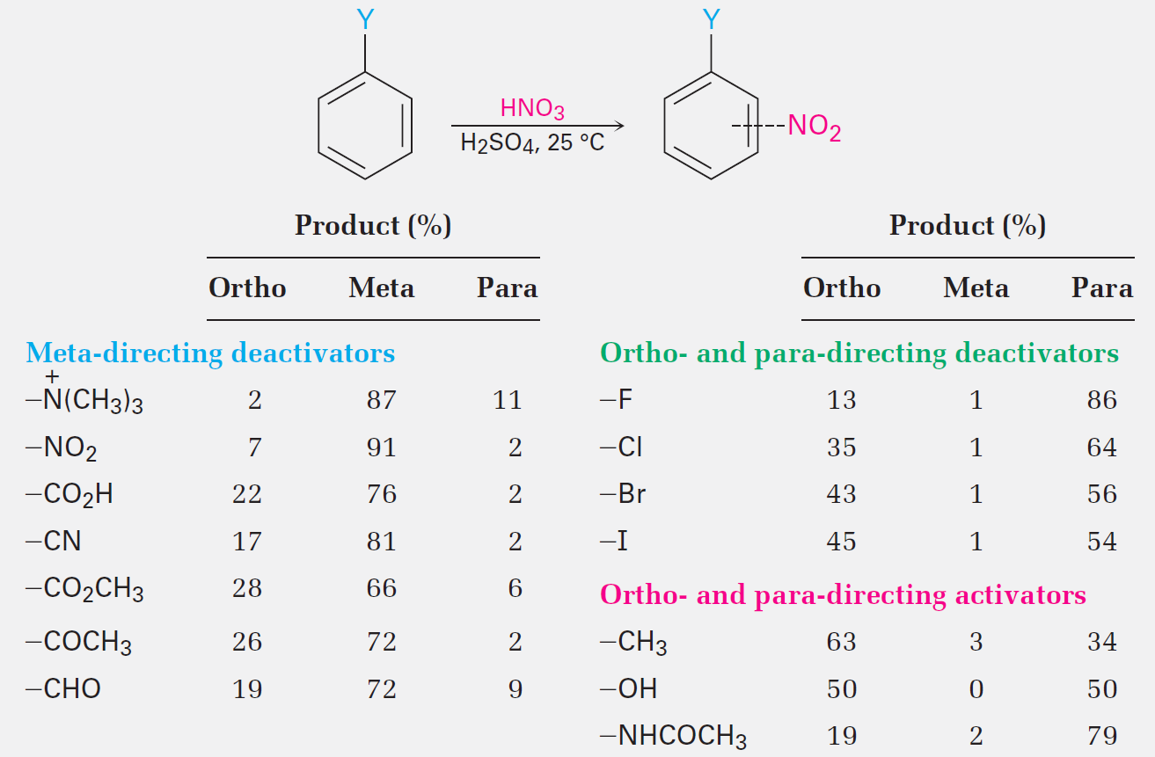
Table 16.1 - Orientation of Nitration in Substituted Bezenes
Notes:
Substituent effects in electrophilic substitutions

Slide 33
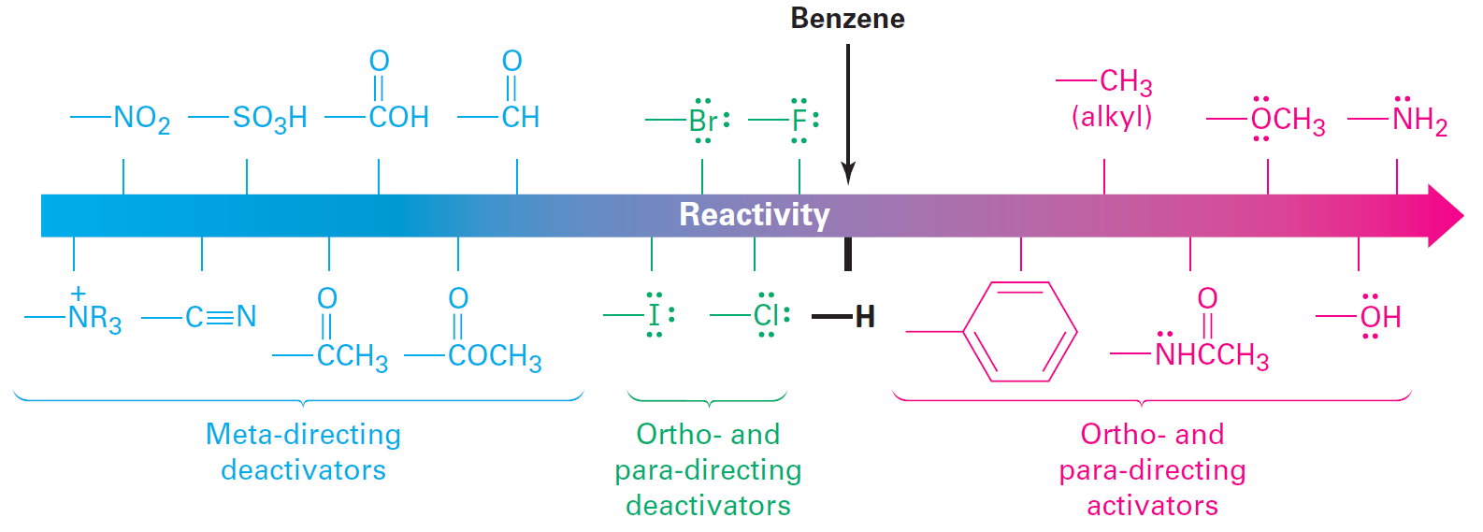
Figure 16.11 - Classification of Substituent Effects in Electrophilic Aromatic Substitution
Notes:
Substituent effects in electrophilic substitutions

Slide 34
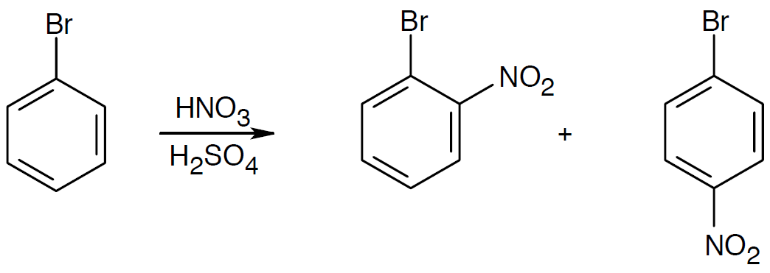
Worked Example
Predict the major product in the nitration of bromobenzene
Solution:
Even though bromine is a deactivator, it is used as an ortho-para director
Notes:
Substituent effects in electrophilic substitutions

Slide 35
Activating or Deactivating Effects
Activating groups contribute electrons to the aromatic ring
The ring possesses more electrons
The carbocation intermediate is stabilized
Activation energy is lowered
Deactivating groups withdraw electrons from the aromatic ring
The ring possesses lesser electrons
The carbocation intermediate is destabilized
Activation energy is increased
Notes:
Substituent effects in electrophilic substitutions

Slide 36
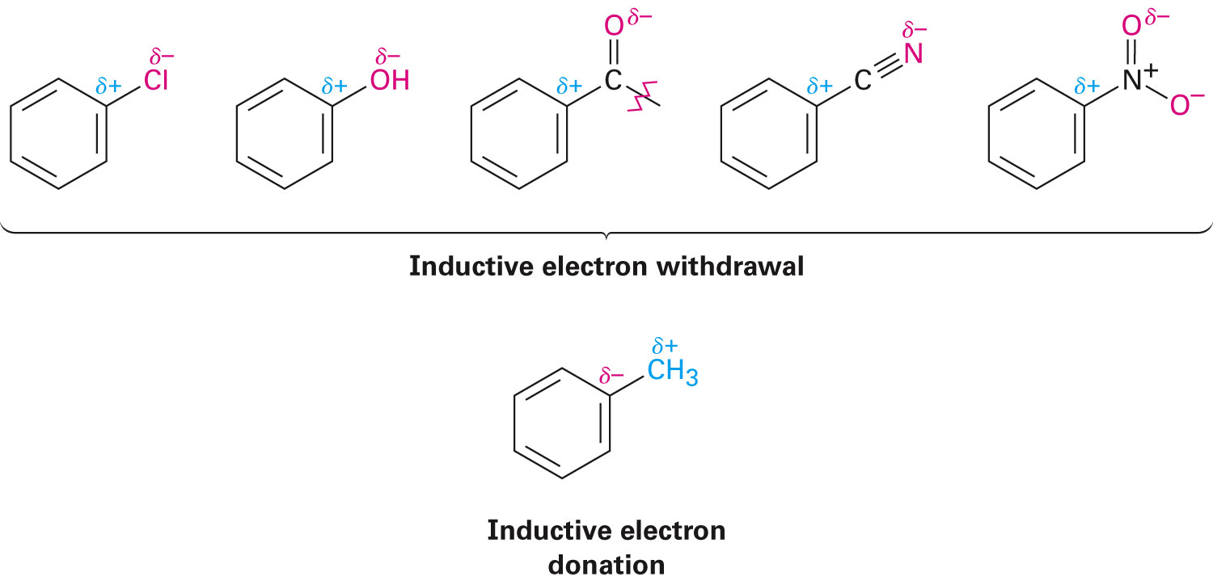
Origins of Substituent Effects
Inductive effect: Withdrawal or donation of electrons by a sigma bond due to electronegativity
Prevalent in halobenzenes and phenols
Notes:
Substituent effects in electrophilic substitutions

Slide 37
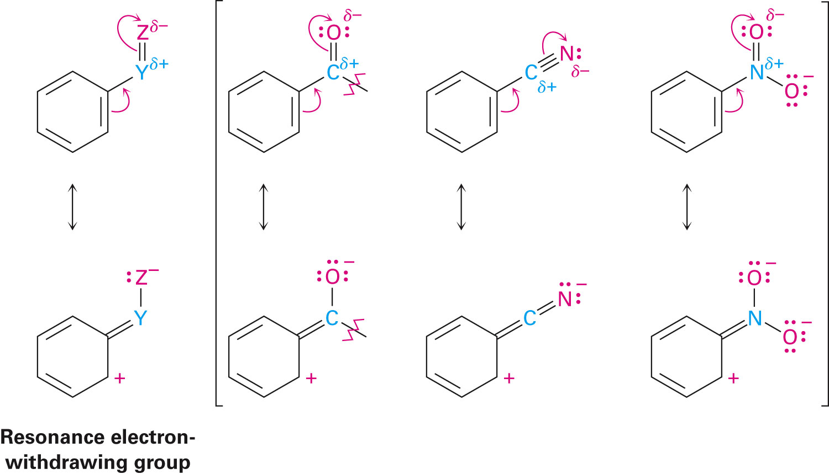
Resonance Effects - Electron Withdrawal
Resonance effect: Withdrawal or donation of electrons through a π bond due to the overlap of a p orbital on the substituent with a p orbital on the aromatic ring
Notes:
Substituent effects in electrophilic substitutions

Slide 38
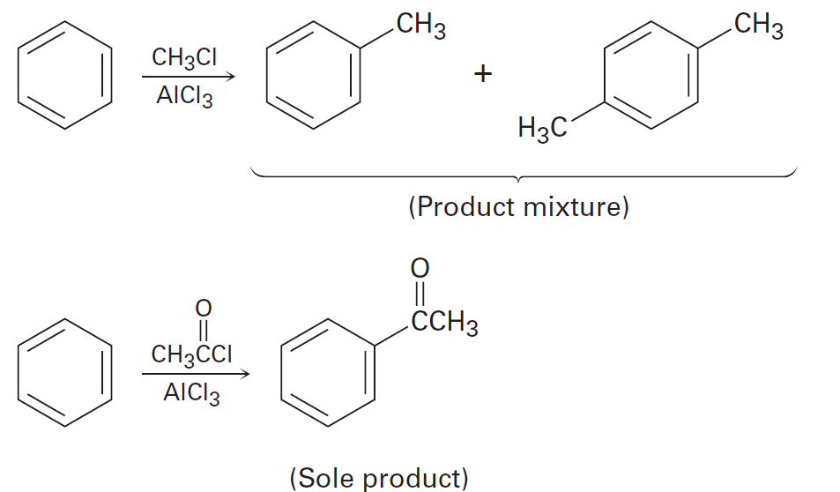
Worked Example
Explain why Freidel-Crafts alkylations often give polymer substitution but Freidel-Crafts acylations do not
Notes:
Substituent effects in electrophilic substitutions

Slide 39
Worked Example
Solution
An acyl substituent if deactivating
Once an aromatic ring has been acylated, it is less reactive to further substitution
An alkyl substituent is activating, however, an alkyl-substituted ring is more reactive than an unsubstituted ring
Polysubstitution occurs readily
Notes:
Substituent effects in electrophilic substitutions

Slide 40
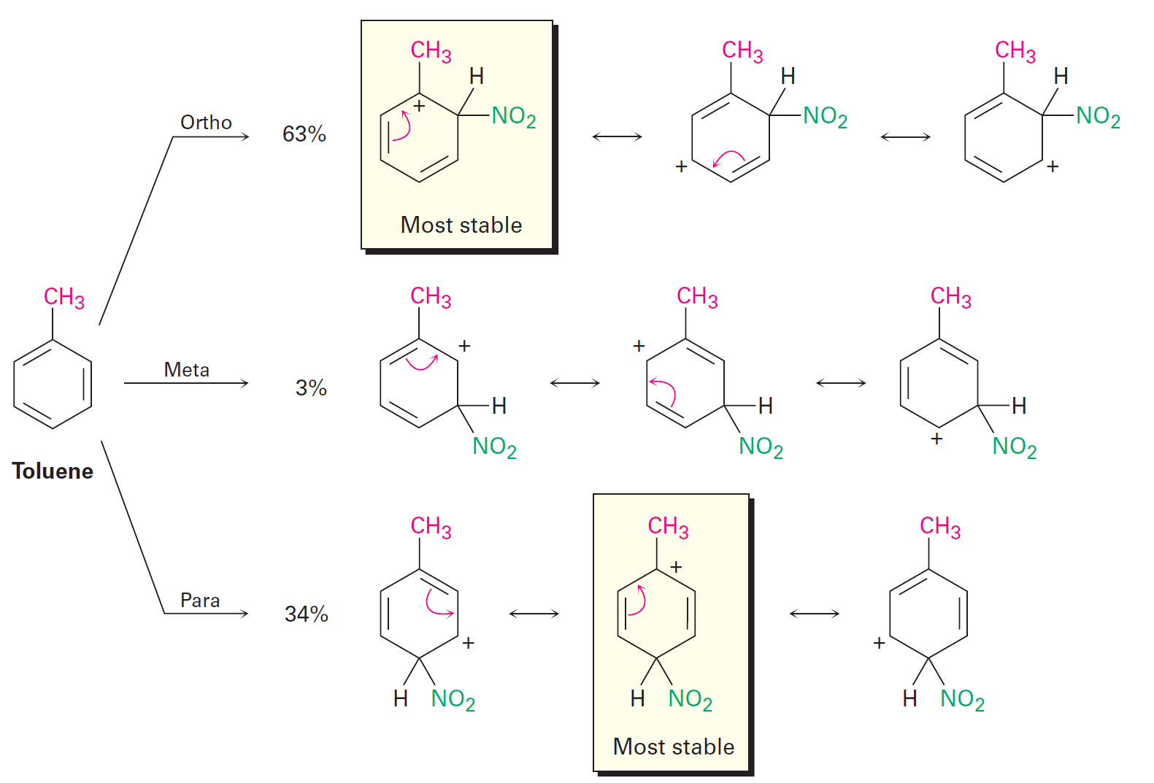
Ortho- and Para-Directing Activators: Alkyl Groups
Alkyl groups possess an electron-dating inductive effect
Notes:
Substituent effects in electrophilic substitutions

Slide 41
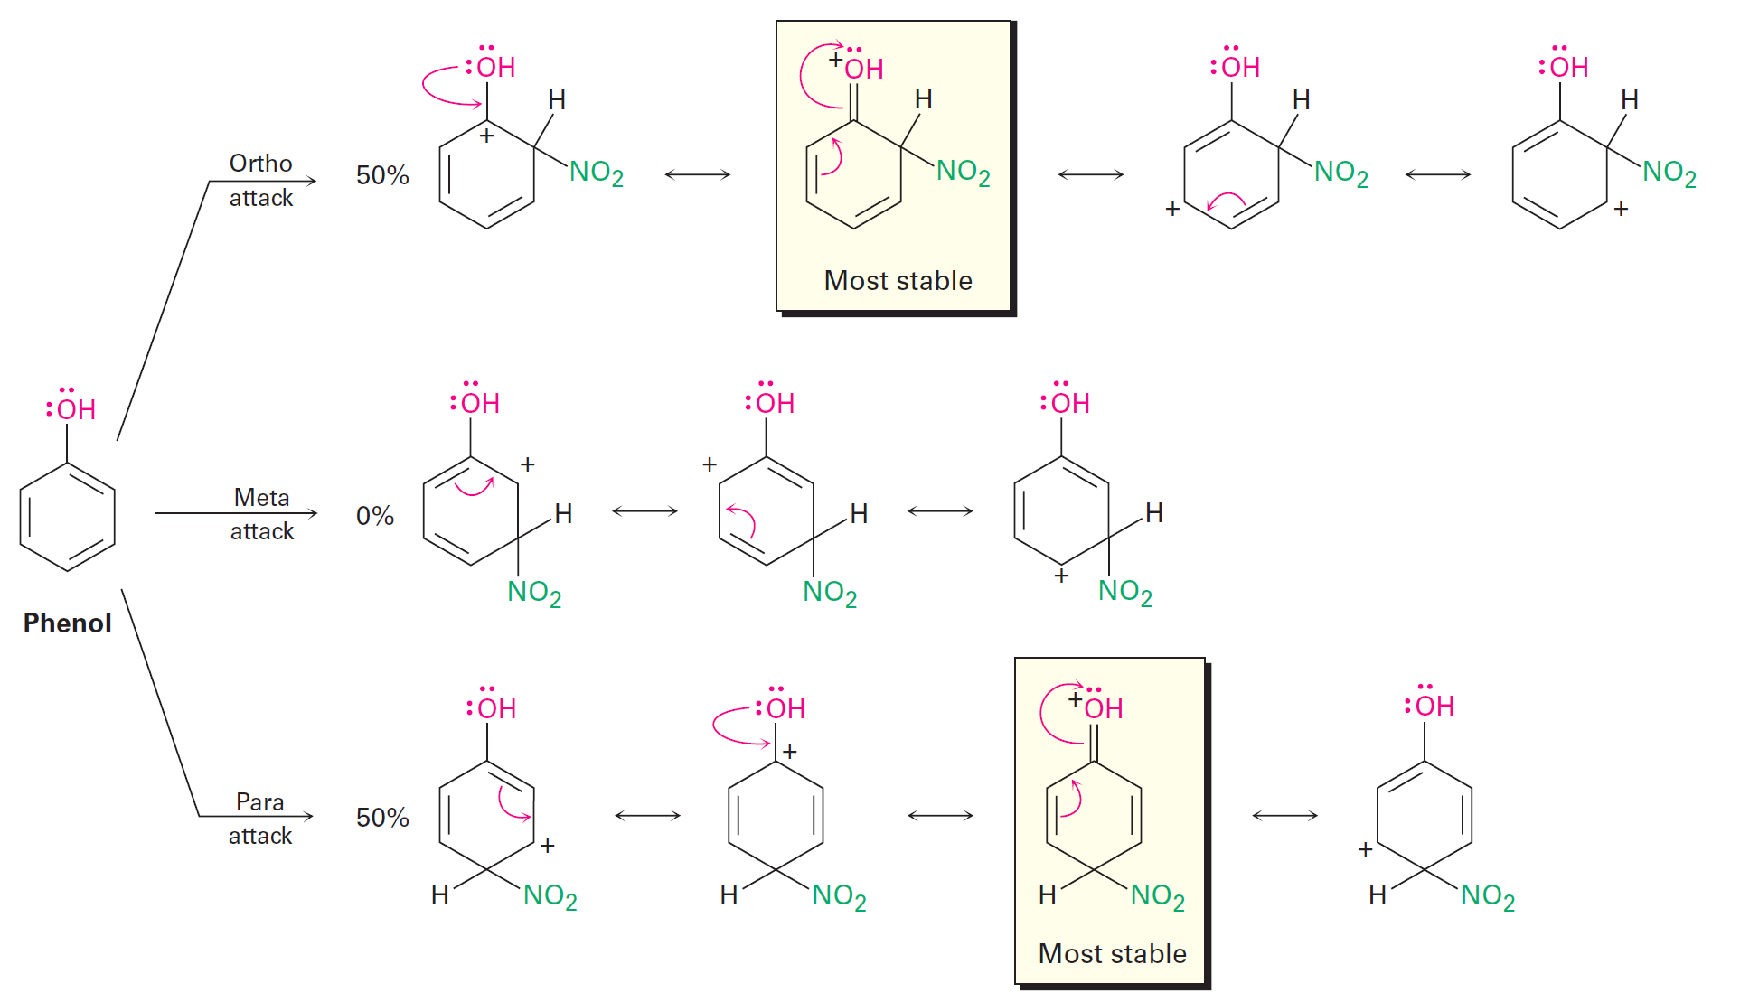
Ortho- and Para-Directing Activators: OH and NH₂
Hydroxyl, alkoxyl, and amino groups possess a strong, electron-donating resonance effect
Notes:
Substituent effects in electrophilic substitutions

Slide 42
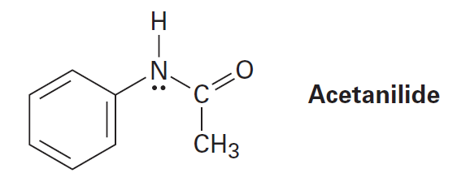
Worked Example
Explain why acetanilide is less reactive than aniline toward electrophilic substitution
Notes:
Substituent effects in electrophilic substitutions

Slide 43
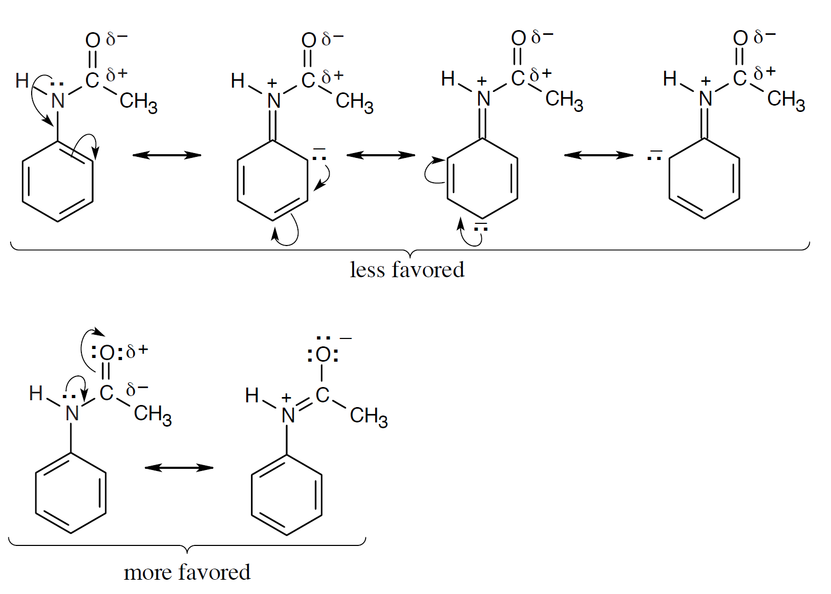
Worked Example
Solution:
Notes:
Substituent effects in electrophilic substitutions

Slide 44
Worked Example
For acetanilide, resonance delocalization of the nitrogen lone pair electrons to the aromatic ring is less favoured
Positive charge on nitrogen is next to the positively polarized carbonyl group
The electronegativity of oxygen favors resonance delocalization to the carbonyl oxygen
In aniline, the decreased availability of nitrogen lone pair electrons results in decreased reactivity of the ring toward electrophilic substitution
Notes:
Substituent effects in electrophilic substitutions

Slide 45
Ortho- and Para-Directing Deactivators: Halogens
Caused by the dominance of the stronger electron-withdrawing inductive effect over their weaker electron-donating resonance effect
Electron donating resonance effect is present only at the ortho and para positions
Ortho and para reactions can cause stabilization of the positive charge in the carbocation intermediates
Meta intermediates take more time to form
Notes:
Substituent effects in electrophilic substitutions

Slide 46
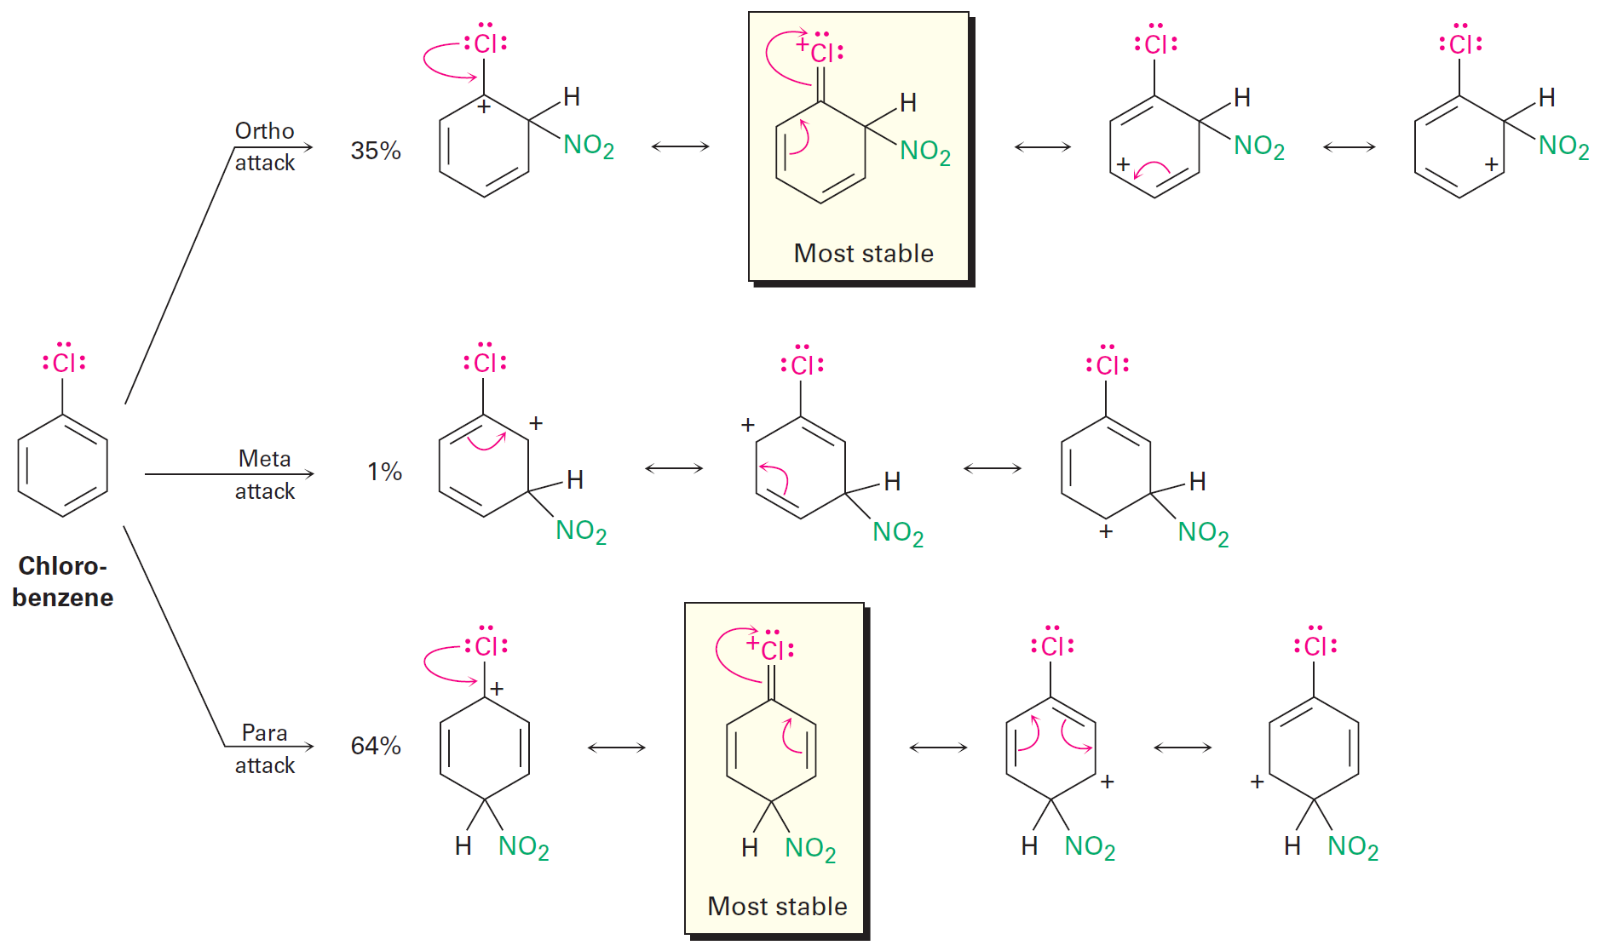
Figure 16.15 - Carbocation Intermediates in the Nitration of Chlorobenzene
Notes:
Substituent effects in electrophilic substitutions

Slide 47
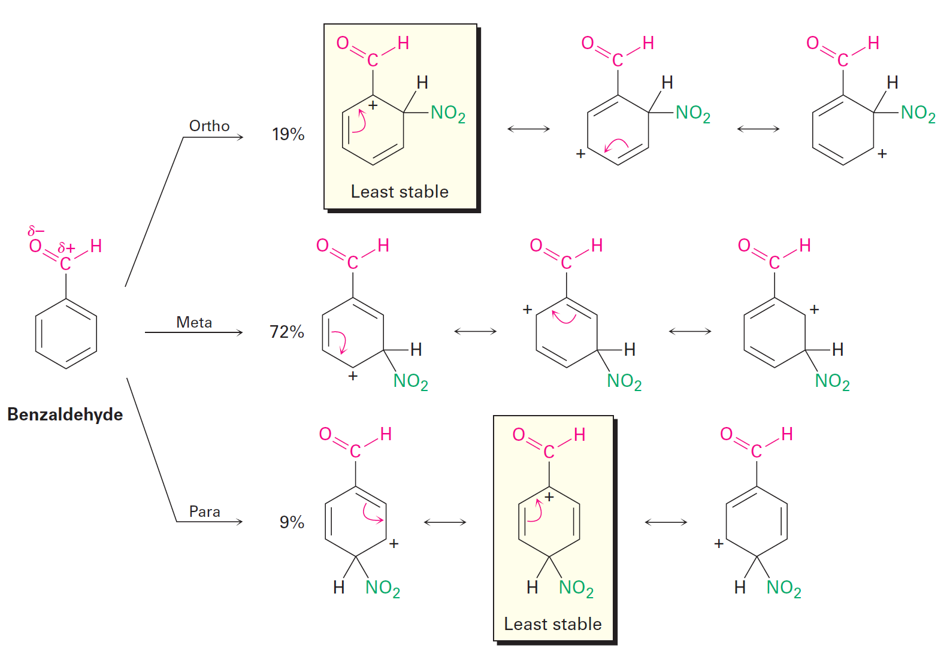
Meta-Directing Deactivators
The meta intermediate possesses three favourable resonance forms
Ortho and para intermediates possess only two
Notes:
Substituent effects in electrophilic substitutions

Slide 48
Worked Example
Draw resonance structures for the intermediates from the reaction of an electrophile at the ortho, meta, and para positions of nitrobenzene
Determine which intermediates are most stable
Notes:
Substituent effects in electrophilic substitutions

Slide 49
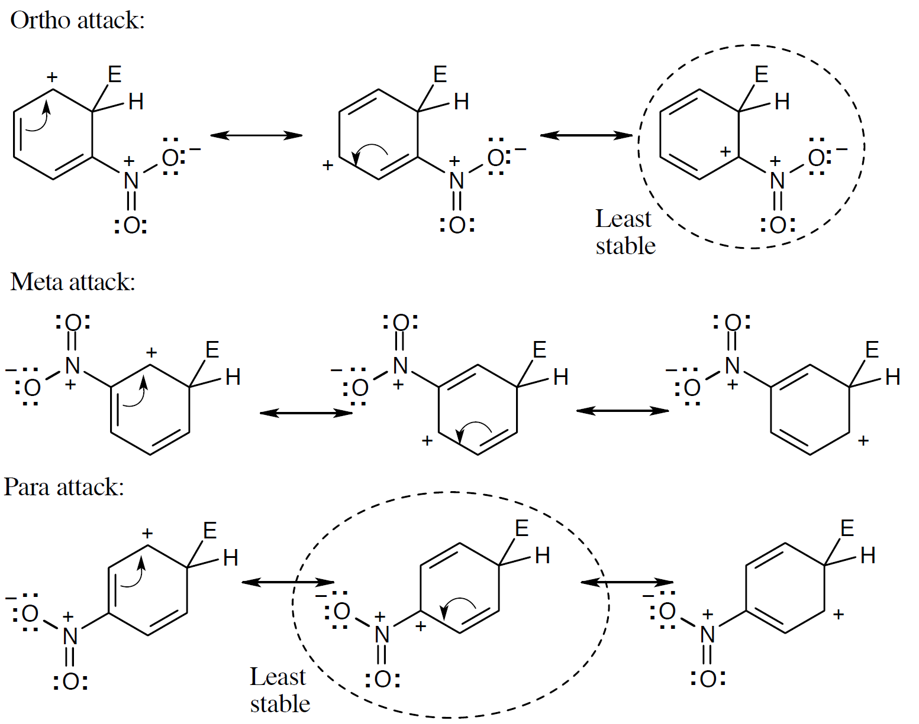
Worked Example
Solution:
Notes:
Substituent effects in electrophilic substitutions

Slide 50
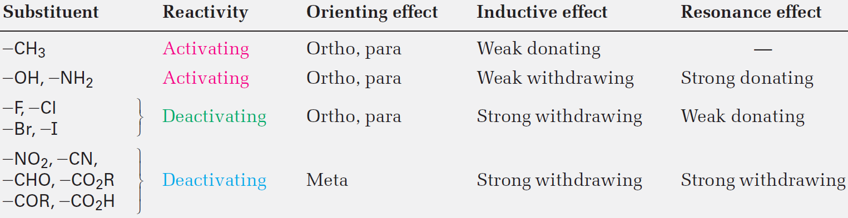
Table 16.2 - Substituent Effects in Electrophilic Aromatic Substitution
Notes:
Substituent effects in electrophilic substitutions

Slide 51
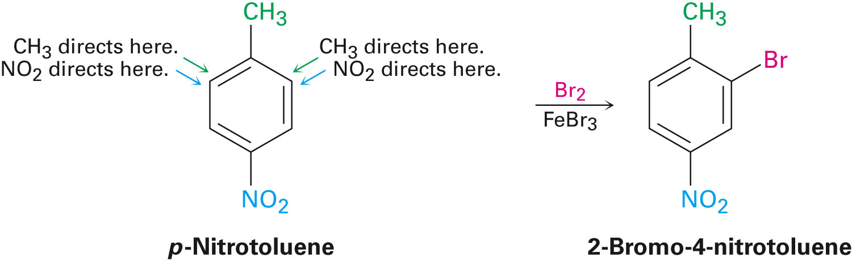
Trisubstituted Benzenes: Additivity of Effects
Additivity effects are based on three rules:
The situation is straightforward if the directing effects of the groups reinforce each other
Notes:
Trisubstituted benzenes: Additivity of effects

Slide 52
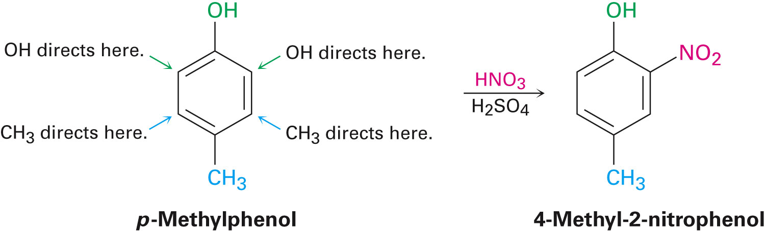
Trisubstituted Benzenes: Additivity of Effects
If the directing effects of two groups oppose each other, the more powerful activating group decides the principal outcome
Usually gives mixtures of products
Notes:
Trisubstituted benzenes: Additivity of effects

Slide 53
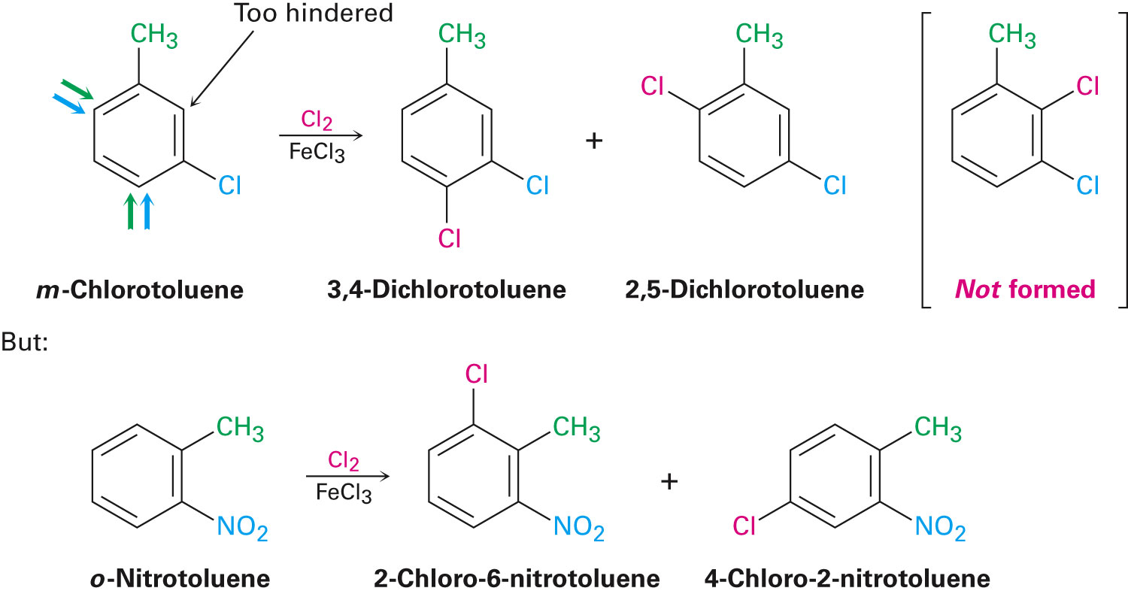
Trisubstituted Benzenes: Additivity of Effects
Further substitution is rare when two groups are in a meta-disubstituted compound as the site is too hindered
An alternate route must be taken in the preparation of aromatic rings with three adjacent substituents
Notes:
Trisubstituted benzenes: Additivity of effects

Slide 54
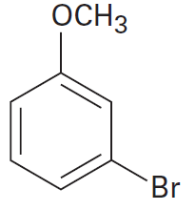
Worked Example
Determine the position at which electrophilic substitution occurs in the following substance
Notes:
Trisubstituted benzenes: Additivity of effects

Slide 55
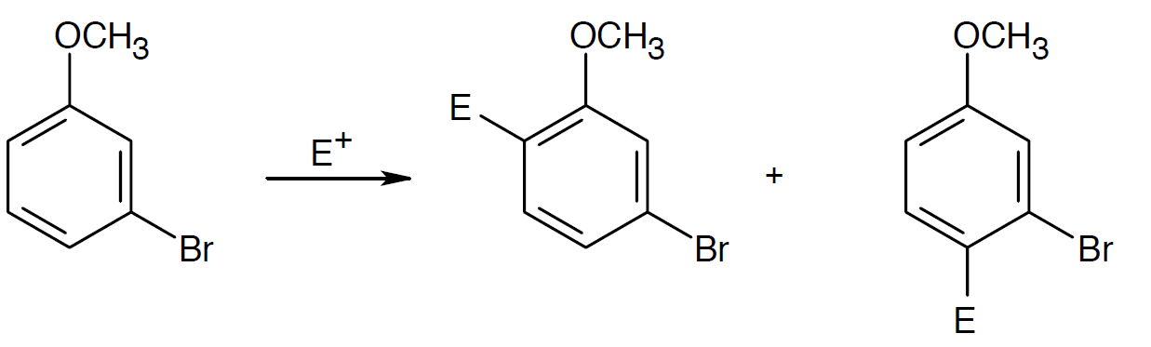
Worked Example
Solution:
Both groups are ortho-para directors and direct substitution to the same positions
Attack does not occur between the two groups for steric reasons
Notes:
Trisubstituted benzenes: Additivity of effects

Slide 56
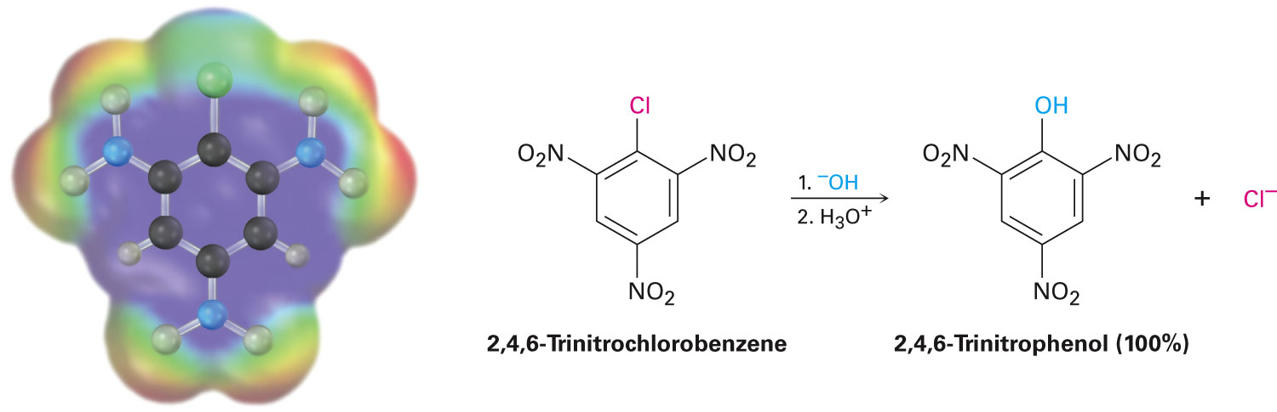
Nucleophilic Aromatic Substitution
Aryl halides with electron-withdrawing substituents can also undergo a nucleophilic substitution reaction
Notes:
Nucleophilic aromatic substitution

Slide 57
Nucleophilic Aromatic Substitution
Not very common
Uses
Reaction of proteins with Sanger’s reagent results in a label being attached to one end of the protein chain
Reaction is superficially similar to the S_{N}1 and S_{N}2 nucleophilic substitutions
Aryl halides are inert to both S_{N}1 and S_{N}2 conditions
Notes:
Nucleophilic aromatic substitution

Slide 58
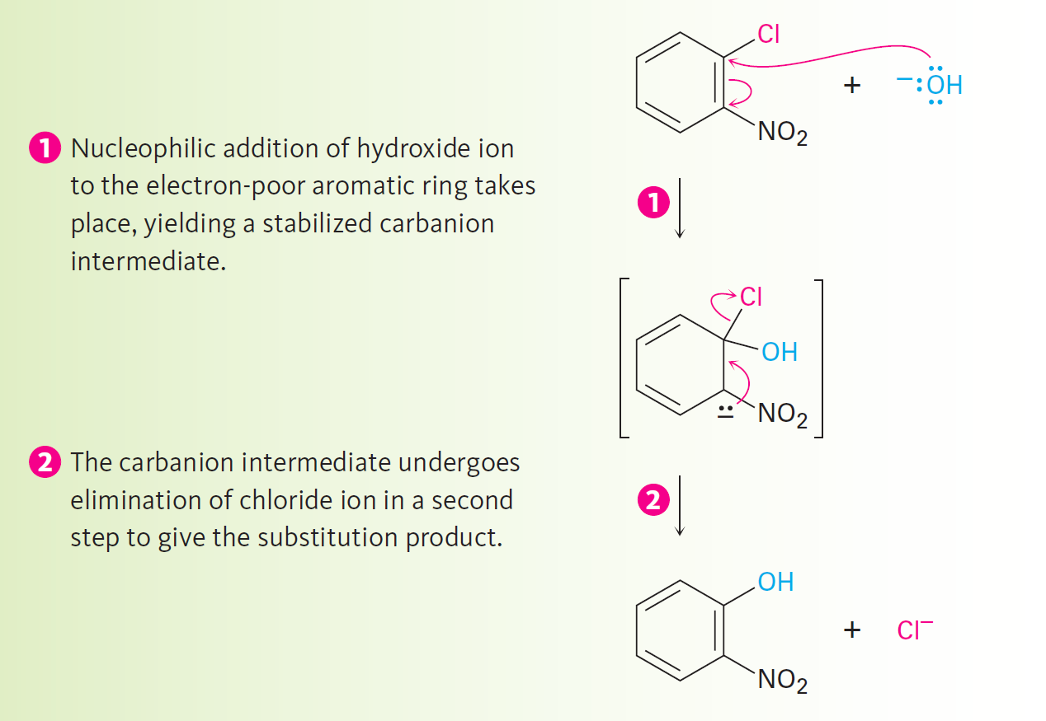
Figure 16.17 - Mechanism of Nucleophilic Aromatic Substitution
Notes:
Nucleophilic aromatic substitution

Slide 59
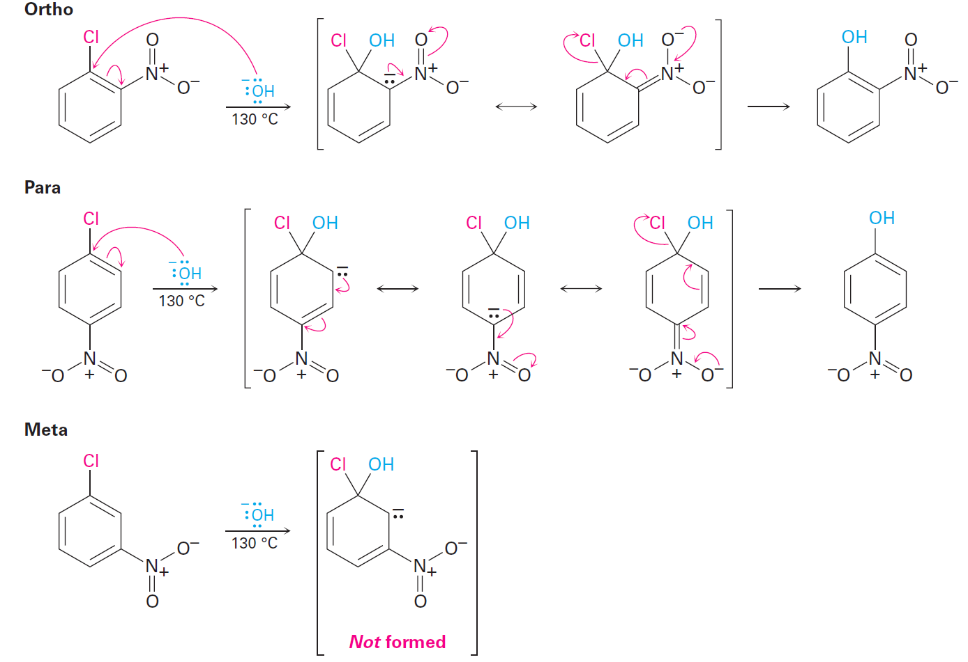
Figure 16.18 - Nucleophilic Aromatic Substitution of Nitrochlorobenzenes
Notes:
Nucleophilic aromatic substitution

Slide 60
Differences Between Electrophilic and Nucleophilic Aromatic Substitutions
Electrophilic substitutions
Nucleophilic substitutions
Favored by electron-donating substituents
Electron-withdrawing groups cause ring deactivation
Electron-withdrawing groups are meta directors
Replace hydrogen on the ring
Favored by electron-withdrawing substituents
Electron-withdrawing groups cause ring activation
Electron withdrawing groups are ortho-para directors
Replace a leaving group
Notes:
Nucleophilic aromatic substitution

Slide 61
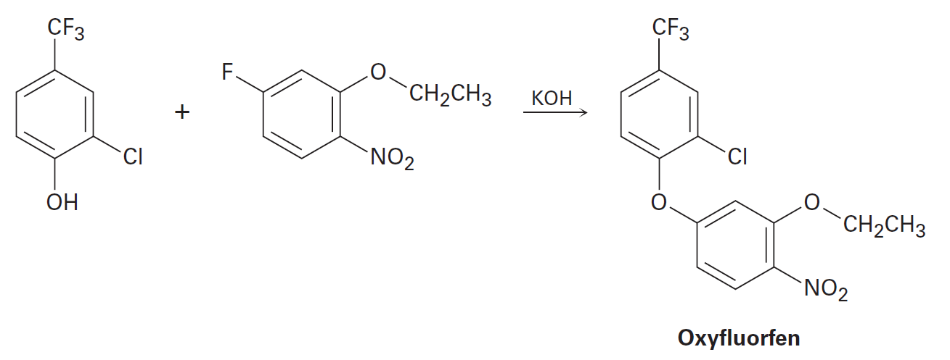
Worked Example
Propose a mechanism for the preparation of oxyfluorfen, a herbicide, through the reaction between phenol and an aryl fluoride
Notes:
Nucleophilic aromatic substitution

Slide 62
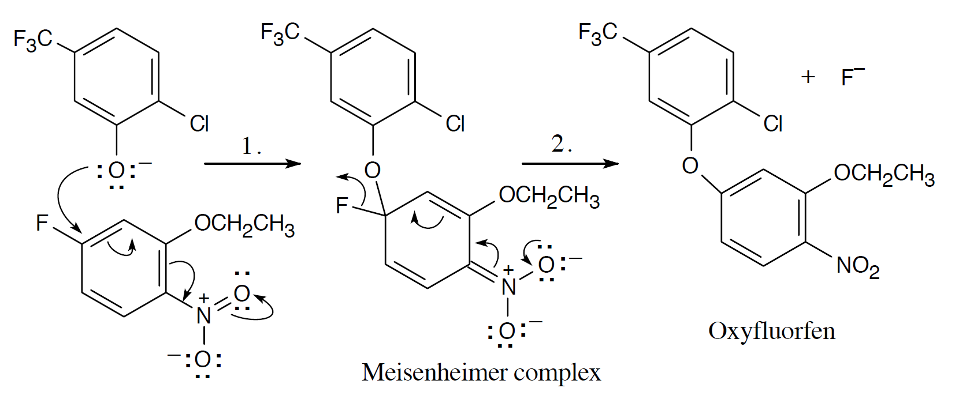
Worked Example
Solution:
Step 1: Addition of the nucleophile
Step 2: Elimination of the fluoride ion
Notes:
Nucleophilic aromatic substitution

Slide 63
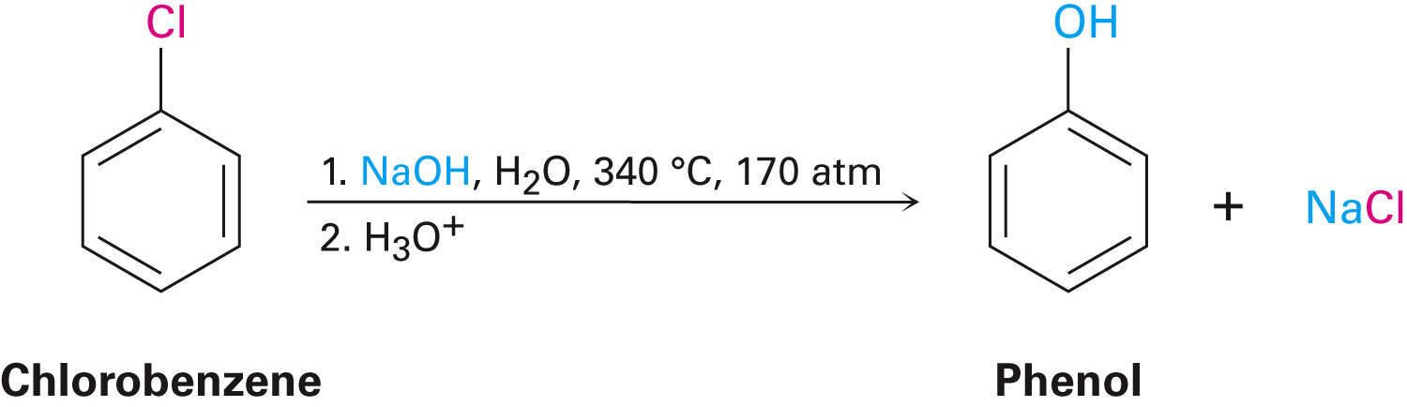
Benzyne
On a general basis, there are no reactions between nucleophiles and halobenzenes that do not have electron withdrawing substituents
High temperatures can be used to make chlorobenzene react
Notes:
Benzyne

Slide 64
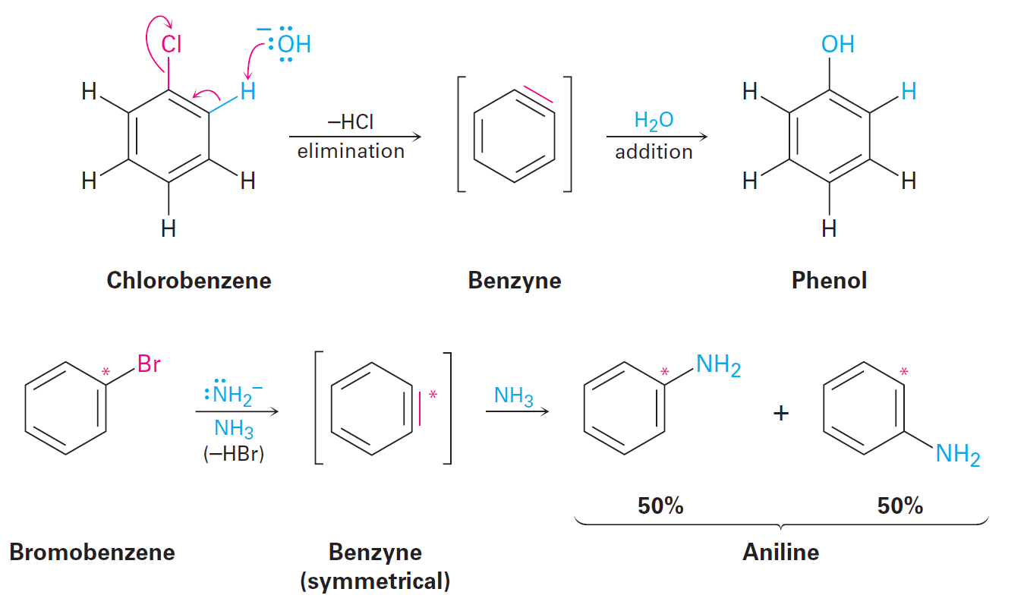
Benzyne
A Diels-Adler reaction occurs when bromobenzene reacts with KNH₂ in the presence of a conjugated diene, such as furan
Elimination of HBr from bromobenzene forms a benzyne as the chemical intermediate
Notes:
Benzyne

Slide 65

Benzyne
Benzyne has the electronic structure of a highly distorted alkyne
The benzyne triple bond uses sp²-hybridized carbon atoms
Notes:
Benzyne

Slide 66
Worked Example
Explain why the treatment of p-toluene with NaOH at 300°C yields a mixture of two products, but treatment of m-bromotoluene with NaOH yields a mixture of two or three products
Notes:
Benzyne

Slide 67

Worked Example
Solution:
Notes:
Benzyne

Slide 68

Oxidation of Aromatic Compounds
In the presence of an aromatic ring, alkyl side chains are converted to carboxyl groups through oxidation
Alkylbenzene is converted to benzoic acid
Notes:
Oxidation of aromatic compounds

Slide 69

Oxidation of Aromatic Compounds
Side-chain oxidation involves a complex mechanism wherein C–H bonds next to the aromatic ring react to form intermediate benzylic radicals
Analogous side-chain reactions are a part of many biosynthetic pathways
Notes:
Oxidation of aromatic compounds

Slide 70

Worked Example
Mention the aromatic substance that is obtained if KMnO₄ undergoes oxidation with the following substance
Notes:
Oxidation of aromatic compounds

Slide 71

Worked Example
Solution:
Oxidation takes place at the benzylic position
Notes:
Oxidation of aromatic compounds

Slide 72

Bromination of Alkylbenzene Side Chains
Occurs when an alkylbenzene is treated with N-bromosuccinimide (NBS)
Notes:
Oxidation of aromatic compounds

Slide 73
Mechanism of NBS (Radical) Reaction
Abstraction of a benzylic hydrogen atom generates an intermediate benzylic radical
Benzylic radical reacts with Br₂ to yield product and a Br⁻ radical
Br⁻ radical cycles back into reaction to carry on the chain
Br₂ is produced when HBr reacts with NBS
Notes:
Oxidation of aromatic compounds

Slide 74

Mechanism of NBS (Radical) Reaction
· ·
Notes:
Oxidation of aromatic compounds

Slide 75

Bromination of Alkylbenzene Side Chains
The reaction of HBr with NBS occurs only at the benzylic position
The benzylic radical intermediate is stabilized by resonance
The p orbital of the benzyl radical overlaps with the ringed π electron system
Notes:
Oxidation of aromatic compounds

Slide 76

Worked Example
Styrene, the simplest alkenylbenzene, is prepared for commercial use in plastics manufacture by catalytic dehydrogenation of ethylbenzene
Prepare styrene from benzene
Notes:
Oxidation of aromatic compounds

Slide 77

Worked Example
Solution:
Notes:
Oxidation of aromatic compounds

Slide 78

Reduction of Aromatic Compounds
Aromatic rings are inert to catalytic hydrogenation under conditions that reduce alkene double bonds
They can selectively reduce an alkene double bond in the presence of an aromatic ring
Notes:
Reduction of aromatic compounds

Slide 79

Reduction of Aromatic Compounds
Reduction of an aromatic ring requires either:
A platinum catalyst and a pressure of several hundred atmospheres
A catalyst such as rhodium or carbon
Notes:
Reduction of aromatic compounds

Slide 80

Reduction of Aryl Alkyl Ketones
An aromatic ring can activate neighboring carbonyl group toward reduction
An aryl alkyl ketone can be converted into an alkylbenzene by catalytic hydrogenation over a palladium catalyst
Notes:
Reduction of aromatic compounds

Slide 81

Reduction of Aryl Alkyl Ketones
Only aryl alkyl ketones can be converted into a methylene group by catalytic hydrogenation
Nitro substituents hinder the catalytic reduction of aryl alkyl ketones
Nitro group undergoes reduction to form an amino group
Notes:
Reduction of aromatic compounds

Slide 82

Worked Example
Prepare diphenylmethane, (Ph)₂CH₂, from benzene and an acid chloride
Solution:
Notes:
Reduction of aromatic compounds

Slide 83
Synthesis of Polysubstituted Benzenes
Working synthesis reactions is one of the best ways to learn organic chemistry
Knowledge on using the right reactions at the right time is vital to a successful scheme
Ability to plan a sequence of reactions in right order is valuable to synthesis of substituted aromatic rings
Notes:
Synthesis of polysubstituted benzenes

Slide 84

Worked Example
Synthesize m-Chloronitrobenzene from benzene
Solution:
In order to synthesize the product with the correct orientation of substituents, benzene must be nitrated before it is chlorinated
Notes:
Synthesis of polysubstituted benzenes

Slide 85
Summary
There are two phases in an electrophilic aromatic substitution reaction:
Initial reaction of an electrophile E⁺
Loss of H⁺ from the resonance-stabilized carbocation intermediate
The Friedel-Crafts alkylation and acylation reactions are important electrophilic aromatic substitution reactions that involve the reaction of an aromatic ring with carbocation electrophiles

Slide 86
Summary
Resonance and inductive effects are the means by which substituents influence aromatic rings
Nucleophilic aromatic substitution is a reaction that halobenzenes go through and involve an addition of a nucleophile to the ring
In halobenzenes that are not activated by electron-withdrawing substituents, nucleophilic aromatic substitutions occur by elimination of HX which yields a benzene

